Slide 1

Unit 2

Slide 2
18CSC202J- Object Oriented Design and Programming
Unit II
Types of Constructor

Slide 3
Agenda : 1) To understand types of Constructor’s. 2) To apply Constructor’s in real time example.

Slide 4
CONSTRUCTORS
It is very common for some part of an object to require initialization before it can be used.
Suppose you are working on 100's of objects and the default value of a particular data member is needed to be zero.
Initializing all objects manually will be very tedious job.
Instead, you can define a constructor function which initializes that data member to zero. Then all you have to do is declare object and constructor will initialize object automatically

Slide 5
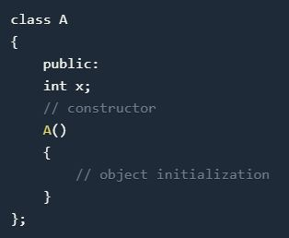
CONSTRUCTORS
While defining a constructor you must remember that the name of constructor will be same as the name of the class, and constructors will never have a return type.

Slide 6
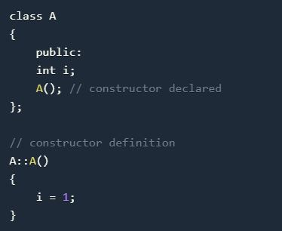
CONSTRUCTORS
Constructors can be defined either inside the class definition or outside class definition using class name and scope resolution :: operator.

Slide 7
CONSTRUCTOR CHARACTERS
They must be declared in the public scope.
They are invoked automatically when the objects are created.
They do not have return types, not even void and they cannot return values.
They cannot be inherited, though a derived class can call the base class constructor.
Like other C++ functions, Constructors can have default arguments.

Slide 8
Constructors cannot be virtual.
We can not refer to their addresses.
An object with a constructor (or destructor) can not be used as a member of a union.
They make ‘implicit calls’ to the operators new and delete when memory allocation is required.

Slide 9
CONSTRUCTOR TYPES
Constructors are of three types:
Default Constructor
Parameterized Constructor
Copy Constructor

Slide 10
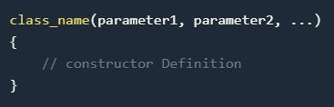
DEFAULT CONSTRUCTOR
Default constructor is the constructor which doesn't take any argument. It has no parameter.
Syntax :

Slide 11
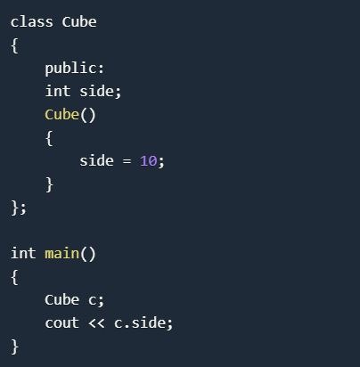
DEFAULT CONSTRUCTOR
Example
Output : 10

Slide 12
DEFAULT CONSTRUCTOR
As soon as the object is created the constructor is called which initializes its data members.
A default constructor is so important for initialization of object members, that even if we do not define a constructor explicitly, the compiler will provide a default constructor implicitly.

Slide 13
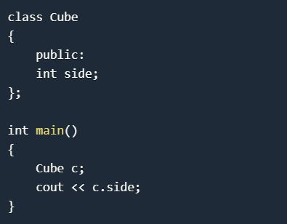
DEFAULT CONSTRUCTOR
Output: 0 or any random value
In this case, default constructor provided by the compiler will be called which will initialize the object data members to default value, that will be 0 or any random integer value in this case.

Slide 14
PARAMETERIZED CONSTRUCTOR
These are the constructors with parameter.
Using this Constructor you can provide different values to data members of different objects, by passing the appropriate values as argument.

Slide 15
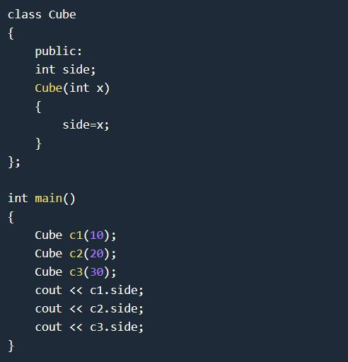
PARAMETERIZED CONSTRUCTOR
OUTPUT
10
20
30

Slide 16
PARAMETERIZED CONSTRUCTOR
By using parameterized constructor in above case, we have initialized 3 objects with user defined values. We can have any number of parameters in a constructor.

Slide 17
COPY CONSTRUCTOR
These are special type of Constructors which takes an object as argument, and is used to copy values of data members of one object into other object.

Slide 18
COPY CONSTRUCTOR
These are special type of Constructors which takes an object as argument, and is used to copy values of data members of one object into other object.
It is usually of the form X (X&), where X is the class name. The compiler provides a default Copy Constructor to all the classes.

Slide 19
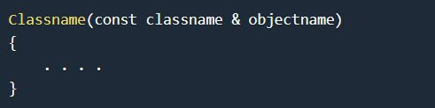
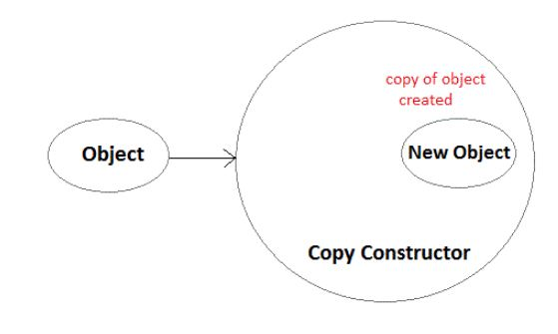
COPY CONSTRUCTOR
As it is used to create an object, hence it is called a constructor. And, it creates a new object, which is exact copy of the existing copy, hence it is called copy constructor.

Slide 20
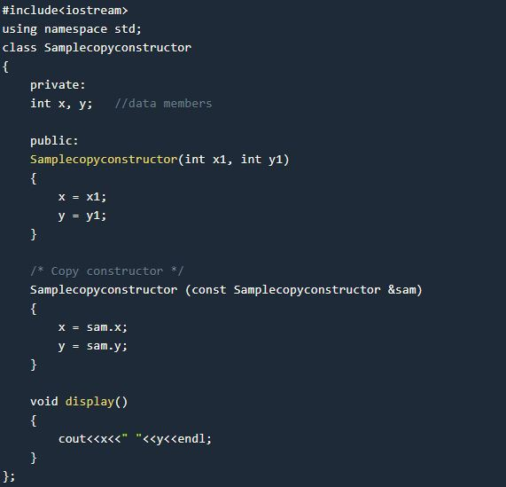
COPY CONSTRUCTOR

Slide 21
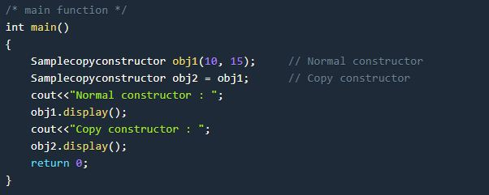
COPY CONSTRUCTOR
Output :
Normal constructor : 10 15
Copy constructor : 10 15

Slide 22
STATIC CONSTRUCTOR
C++ doesn’t have static constructors but you can emulate them using a static instance of a nested class.
class has_static_constructor {
friend class constructor;
struct constructor {
constructor() { /* do some constructing here … */ }
};
static constructor cons;
};
// C++ needs to define static members externally.
has_static_constructor::constructor has_static_constructor::cons;

Slide 23
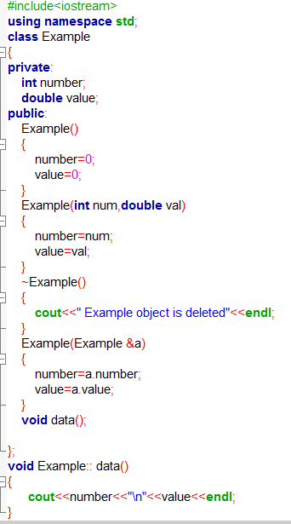
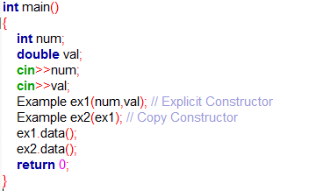
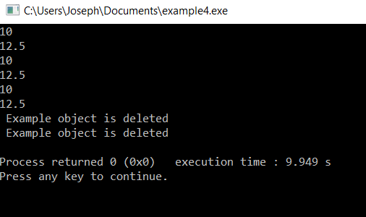
Try out program

Slide 24
Questions
What is a copy constructor? a) A constructor that allows a user to move data from one object to another b) A constructor to initialize an object with the values of another object c) A constructor to check the whether to objects are equal or not d) A constructor to kill other copies of a given object.
What happens if a user forgets to define a constructor inside a class? a) Error occurs b) Segmentation fault c) Objects are not created properly d) Compiler provides a default constructor to avoid faults/errors.
How many parameters does a copy constructor require? a) 1 b) 2 c) 0 d) 3

Slide 25
Unit 2-
Polymorphism - OVERLOADING

Slide 26
Introduction
The word “polymorphism” means having many forms.
In simple words, we can define polymorphism as the ability of a message to be displayed in more than one form

Slide 27
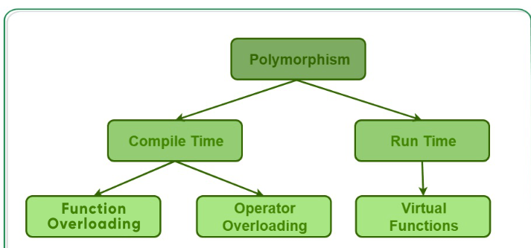
Types of Polymorphism
Basically, there are two types of polymorphism:
Compile time (or static) polymorphism
Run-time (or dynamic) polymorphism.
Static polymorphism -> Method overloading - calls a function using the best match technique or overload resolution.
© Oxford University Press 2015. All rights reserved.

Slide 28
Overloading in C++
What is overloading?
– Overloading means assigning multiple meanings to a function name or operator symbol
– It allows multiple definitions of a function with the same name, but different signatures.
C++ supports
– Function overloading
– Operator overloading

Slide 29
Why is Overloading Useful?
Function overloading allows functions that conceptually perform the same task on objects of different types to be given the same name.
Operator overloading provides a convenient notation for manipulating user-defined objects with conventional operators.

Slide 30
Operator Overloading
Operator overloading
Enabling C++’s operators to work with class objects
Using traditional operators with user-defined objects
Requires great care; when overloading is misused, program difficult to understand

Slide 31
Operator Overloading
Examples of already overloaded operators
Operator << is both the stream-insertion operator and the bitwise left-shift operator
+ and -, perform arithmetic on multiple types
Compiler generates the appropriate code based on the manner in which the operator is used

Slide 32
General Rules for Operator Overloading
Overloading an operator - Write function definition as normal
Syntax:
returnType classname::operator op(arguments)
{
Function body;
} Function name is keyword operator followed by the symbol for the operator being overloaded

Slide 33
General Rules for Operator Overloading
Using operators
To use an operator on a class object it must be overloaded unless the assignment operator(=)or the address operator(&)
Assignment operator by default performs memberwise assignment
Address operator (&) by default returns the address of an object

Slide 34
Steps
1. Create a class that is to be used
2.Declare the operator function in the public part of the class. It may be either member function or friend function.
3.Define operator function to implement the operation required
4.Overloaded can be invoked using the syntax such as: op x;

Slide 35
Restrictions on Operator Overloading
Following C++ Operator can’t be overloaded
Class member access operators(. & .*)
Scope Resolution Operator(::)
Sizeof Operator(sizeof())
Conditional Operator(? :)

Slide 36
Restrictions on Operator Overloading
Overloading restrictions
Precedence ,associativity, arity (number of operands) of an operator cannot be changed
No new operators can be created
Use only existing operators
No overloading operators for built-in types
Cannot change how two integers are added

Slide 37
Overloadable Operators
+ | - | * | / | % | ^
& | | | ~ | ! | , | =
< | > | <= | >= | ++ | --
<< | >> | == | != | && | ||
+= | -= | /= | %= | ^= | &=
|= | *= | <<= | >>= | [] | ()
-> | ->* | new | new [] | delete | delete []
Non-overloadable Operators
:: | .* | . | ?:

Slide 38
Approaches
Operator Overloading can be done by using three approaches, they are
Overloading unary operator.
Overloading binary operator.
Overloading binary operator using a friend function.

Slide 39
Overloading the assignment operator
The assignment operator (operator=) is used to copy values from one object to another already existing object.
Assignment vs Copy constructor
The purpose of the copy constructor and the assignment operator are almost equivalent -- both copy one object to another.
However, the copy constructor initializes new objects, whereas the assignment operator replaces the contents of existing objects.
The difference between the copy constructor and the assignment operator causes a lot of confusion for new programmers, but it’s really not all that difficult. Summarizing:
If a new object has to be created before the copying can occur, the copy constructor is used (note: this includes passing or returning objects by value).
If a new object does not have to be created before the copying can occur, the assignment operator is used.

Slide 40
#include <iostream>
using namespace std;
class Distance {
private: int feet; // 0 to infinite
int inches; // 0 to 12
public: // required constructors
Distance() { feet = 0; inches = 0; }
Distance(int f, int i)
{ feet = f; inches = i; }
void operator = (const Distance &D )
{ feet = D.feet; inches = D.inches; }
// method to display distance
void displayDistance() { cout << "F: " << feet << " I:“ << inches << endl;
} };
int main()
{ Distance D1(11, 10), D2(5, 11);
cout << "First Distance : "; D1.displayDistance();
cout << "Second Distance :"; D2.displayDistance();
// use assignment operator
D1 = D2; cout << "First Distance :";
D1.displayDistance(); return 0; }
Output:
First Distance : F: 11 I:10 Second Distance :F: 5 I:11 First Distance :F: 5 I:11

Slide 41
Binary Operator Overloading
// CPP program to illustrate
// Operator Overloading
#include<iostream>
using namespace std;
class Complex {
private:
int real, imag;
public:
Complex(int r = 0, int i =0) {real = r; imag = i;}
// This is automatically called when '+' is used with
// between two Complex objects
Complex operator + (Complex const &obj) {
Complex res;
res.real = real + obj.real;
res.imag = imag + obj.imag;
return res;
}
void print() { cout << real << " + i" << imag << endl; }
};
int main()
{
Complex c1(10, 5), c2(2, 4);
Complex c3 = c1 + c2; // An example call to "operator+"
c3.print();
}

Slide 42
Operator Overloading MCQ
Which is the correct example of a unary operator? a) & b) == c) — d) /
What is a binary operator give example?
a) Operator that performs its action on a single operand, ++ b) Operator that performs its action on two operand , -- c) Operator that performs its action on three operand , Dereferencing operator(*) d) Operator that performs its action on any number of operands , +

Slide 43
Given the following C++ code. How would you define the < operator for Box class so that when boxes b1 and b2 are compared in if block the program gives correct result?
#include <iostream>
#include <string>
using namespace std;
class Box {
int capacity;
public: Box(){}
Box(double capacity){
this->capacity = capacity; } };
int main(int argc, char const *argv[]) {
Box b1(10);
Box b2 = Box(14);
if(b1 < b2){
cout<<"Box 2 has large capacity.";
} else{
cout<<"Box 1 has large capacity.";
} return 0; }

Slide 44
Answers:
bool operator<(Box b) { return this->capacity < b.capacity ? true : false; }
b) bool operator<(Box b) { return this->capacity > b.capacity ? true : false; }
c) bool operator<(Box b) { return b1 > b2 ? true : false; }
d) bool operator<(Box b) { return this < b ? true : false; }

Slide 45
Function Overloading

Slide 46
Agenda : 1) To understand about method overloading 2) To apply method overloading in real time example.

Slide 47
Function Overloading
Is the process of using the same name for two or more functions
Requires each redefinition of a function to use a different function signature that is:
different types of parameters,
or sequence of parameters,
or number of parameters
Is used so that a programmer does not have to remember multiple function names

Slide 48
Method Overloading
Method overloading is a feature in C++ that allows creation of several methods with the same name but with different parameters.
For example, print(), print(int), and print("Hello") are overloaded methods.
While calling print() , no arguments are passed to the function
When calling print(int) and print("Hello") , an integer and a string arguments are passed to the called function.
Allows one function to perform different tasks

Slide 49

MATCHING FUNCTION CALLS WITH OVERLOADED METHODS
When an overloaded function is called, one of the following cases occurs:
Case 1: A direct match is found, and there is no confusion in calling the appropriate overloaded function.
Case 2: If a match is not found, a linker error will be generated. However, if a direct match is not found, then, at first, the compiler will try to find a match through the type conversion or type casting.
Case 3: If an ambiguous match is found, that is, when the arguments match more than one overloaded function, a compiler error will be generated. This usually happens because all standard conversions are treated equal.

Slide 50
Function Overloading
Two or more functions can have the same name but different parameters
Example:
int max(int a, int b)
{
if (a>= b)
return a;
else
return b;
}
float max(float a, float b)
{
if (a>= b)
return a;
else
return b;
}

Slide 51
Overloading Function Call Resolution
Overloaded function call resolution is done by compiler during compilation
– The function signature determines which definition is used
a Function signature consists of:
– Parameter types and number of parameters supplied to a function
a Function return type is not part of function signature and is not used in function call resolution

Slide 52
Function overloading example:
void sum(int,int);
void sum(double,double);
void sum(char,char);
void main()
{
int a=10,b=20 ;
double c=7.52,d=8.14;
char e=‘a’ , f=‘b’ ;
sum(a,b);
//calls sum(int x,int y)
sum(c,d);
alls sum (double x,double y)
sum(e,f);
// calls sum(char x,char y)
}
void sum(int x,int y)
{
vout<<“\n sum of integers are”<<x+y;
}
void sum(double x,double y){
cout<<“\n sum of two floating no are”<<x+y;
}
void sum(char x,char y)
{
cout<<“\n sum of characters are”<<x+y;
}
Output:
Sum of integers 30
sum of two floating no are 15.66
sum of characters are 195
Notes:
Multiple function with same name and same number of parameters differ only in data types

Slide 53
Function overloading example:
#include<iostream>
Using namespace std;
void area(int x)
{ cout<<“area is”<<x*x;
}
void area(int x,int y)
{cout<<“area of rectang;e”=<<x*y;
}
void area(int x,int y,int z)
{cout<<“volume is”<<x*y*z;
}
int main(){
int side=10,le=5,br=6,a=4,b=5,c=6;
area(side);
area(le,br);
area(a,b,c);
return 0;}

Slide 54
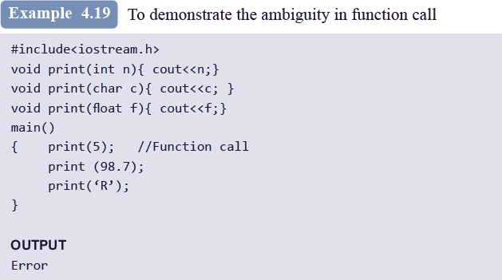

Slide 55
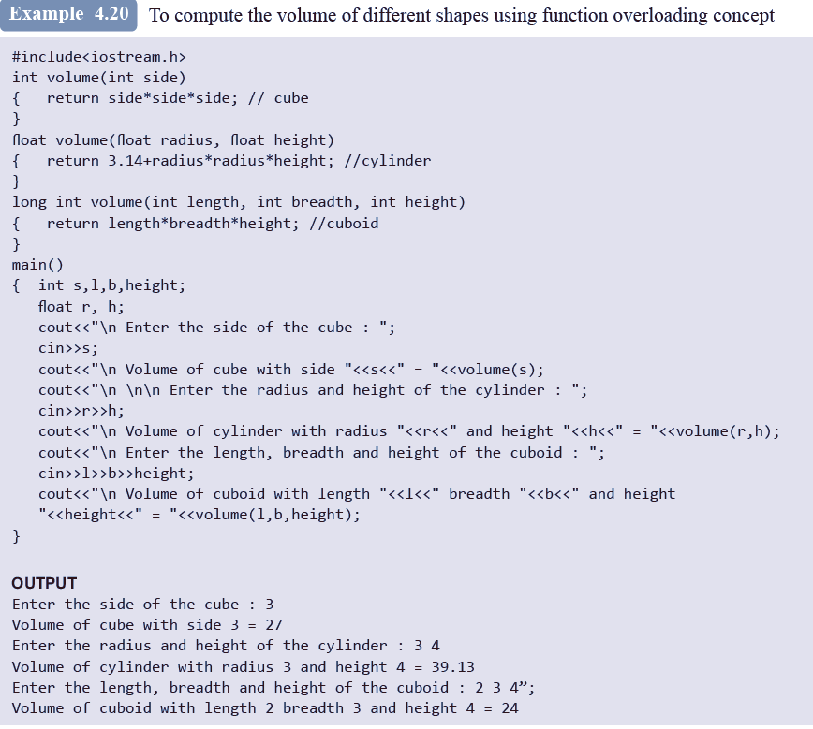

Slide 56
Function Selection Involves following Steps.
Compiler first tries to find the Exact match in which the type of argument are the same,and uses that func.
If an exact match is not found,the compiler user the integral promotions to the actual argument such as,char to int, float to double.
When either of them fails ,build in conversions are used(implicit conversion) to the actual arguments and then uses the function whose match is unique. But if there are multiple matches, then compiler will generate an error message.

Slide 57
For ex: long square(long n)
long square(double x)
Now a func. call such as square(10) will cause an error because int argument can be converted into long also and double also.so it will show ambiguity.
User defined conversion are followed if all the conversion are failed.

Slide 58
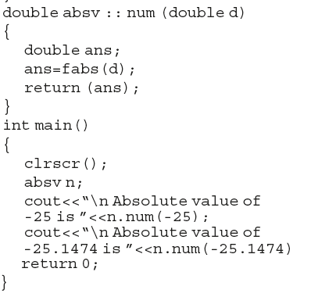
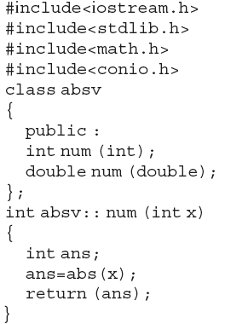
Overload Member function
Takes sample property as member function.
Note : Need to be explained with all function overloading concept.

Slide 59
Methods that Cannot be Overloaded
Methods that differ only in the return type
Parameter declarations that differ only in a pointer * versus an array []
If paramters differ only in the prescence or absence of const and/or volatile
Using typedef does not introduce a new type, hence cannot be overloaded
Methods that differ only in their default arguments
Methods that differ only in a reference parameter and a normal parameter

Slide 60
Method overloading- Points to Remember
There are multiple definitions for the same function name in the same scope
The definitions of these functions vary according to the types and/or the number of arguments in the argument list
Data type of the return value is not considered while writing overloaded functions because the appropriate function is called at the compile time while the return value will be obtained only when the function is called and executed

Slide 61
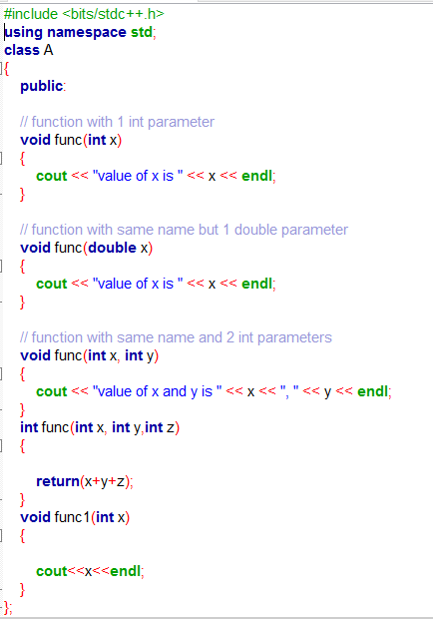
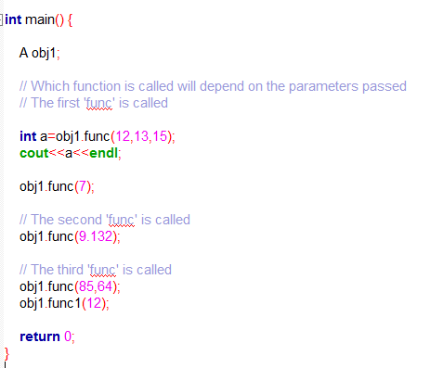
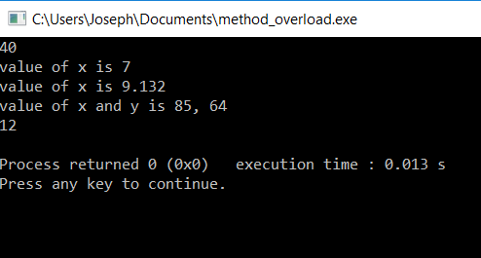
Try out Program

Slide 62
Questions
Which of the following permits function overloading on c++? a) type b) number of arguments c) type & number of arguments d) number of objects
Overloaded functions are ________________ a) Very long functions that can hardly run b) One function containing another one or more functions inside it c) Two or more functions with the same name but different number of parameters or type d) Very long functions
What should be passed in parameters when function does not require any parameters? a) void b) blank space c) both void & blank space d) tab space

Slide 63



Slide 64

The utility of operators such as +, =, *, /, >, <, and so on is predefined in any programming language.
Programmers can use them directly on built-in data types to write their programs.
However, these operators do not work for user-defined types such as objects.
Therefore, C++ allows programmers to redefine the meaning of operators when they operate on class objects.
This feature is called operator overloading

Slide 65
Operator Overloading:
Operator – It is a symbol that indicates an operation. Arithmetic operators are + (add two numbers), - (subtract two numbers), * ( Multiply two numbers), / ( Divide between two numbers).
At now, we will take an Addition ‘+’ Sign, its use of ‘+’ sign is
5+5=10
2.5+2.5=5

Slide 66

Operator Overloading means multiple functions or multiple jobs. In operator overloading the ‘+’ sign use of add the two objects.
One of C++’s great features is its extensibility, Operator Overloading is major functionality related to extensibility.
In C++, most of operators can be overloaded so that they can perform special operations relative to the classes you create.

Slide 67
For Example, ‘+’ operator can be overloaded to perform an operation of string concatenation along with its pre-defined job of adding two numeric values.
When an operator is overloaded, none of its original meaning will be lost.
After overloading the appropriate operators, you can use C++’s built in data types.

Slide 68
Unary Operator
- Operators attached to a single operand. (-a, +a, --a, ++a, a--, a++)
Binary Operator
- Operators attached to two operand. (a-b, a+b, a*b, a/b, a%b, a>b, a<b )

Slide 69

return-type class-name:: operator op(arg-list)
{
function body
}
EXPLANATION
return type – It is the type of value returned by the specified operation.
op - It is the operator being overloaded. It may be unary or
binary operator. It is preceded by the keyword operator.
operator op - It is the function name, Where operator is a keyword.

Slide 70
Introduction
One of the exciting features of C++
Works only on the single variable
It can be overloaded two ways
Static member function
Friend function
-,+,++,-- those are unary operator which we can overloaded.

Slide 71
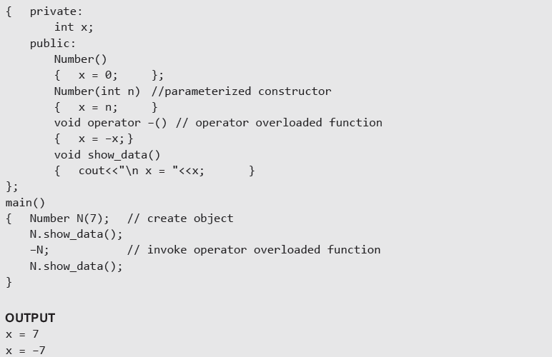
Using a member function to Overload Unary Operator

Slide 72
Using a Friend Function to Overload a Unary Operator
The function will take one operand as an argument.
This operand will be an object of the class.
The function will use the private members of the class only with the object name.
The function may take the object by using value or by reference.
The function may or may not return any value.
The friend function does not have access to the this pointer.

Slide 73
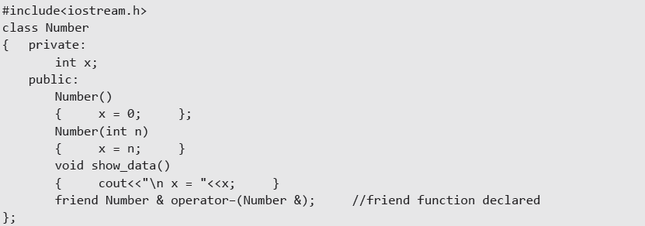
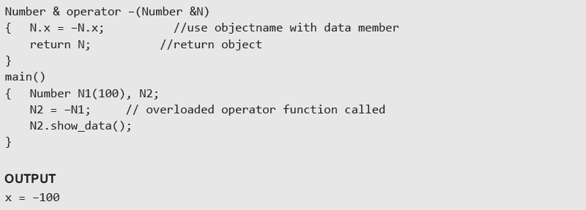
Example:- Use of friend function to overload a unary operator

Slide 74
Example Program:
Write a program which will convert an positive values in an object to negative value.
Code:
#include <iostream>
class demo
{
int x,y,z; public:
void getdata (int a, int b,int c)
{
x=a;
y=b; z=c;
}
Contd...,

Slide 75
void display(); void operator –();
};
void demo::display()
{
cout<<“x=“<<x<<“\ny=“<<y<<“\nz=“<<z<<endl;
}
void demo::operator –()
{
x=-x;
y=-y;
z=-z;
}
int main()
{
demo obj1;
CONTD...,

Slide 76
obj1.getdata(10,20,30); obj1.display();
-obj1; obj1.display(); return 0;
}
Output:
x=10
y=20 z=30
x=-10 y=-20 z=-30

Slide 77


Slide 78
INTRODUCTION
In Binary operator overloading function, there should be one argument to be passed.
It is overloading of an operator operating on two operands.

Slide 79
#include<iostream> class multiply
{
int first,second;
public:
void getdata(int a,int b)
{
first=a; second=b;
}
Contd...,

Slide 80
void display()
{
cout<<“first=“<<first<<“second=“<<secon<<endl;
}
multiply operator *(multiply c);
};
void multiply::operator *(multiply c)
{
multiply temp; temp.first=first*c.first; temp.second=second*c.second; return temp;
}
Contd..,

Slide 81
int main()
{
multiply obj1,obj2,obj3; obj1.getdata(15,20); obj2.getdata(3,45); obj3=obj1*obj2; obj3.display();
return 0;
}
Output:
45
900

Slide 82
18CSC202J- Object Oriented Design and Programming
Unit II
UML Sequence Diagram

Slide 83
Agenda : 1) To understand about interaction diagram 2) To draw sequence diagram using StarUML

Slide 84
Interaction Diagram
Interaction diagrams are used to observe the dynamic behavior of a system.
Interaction diagram visualizes the communication and sequence of message passing in the system.
Interaction diagram represents the structural aspects of various objects in the system.
Interaction diagram represents the ordered sequence of interactions within a system.
Interaction diagram provides the means of visualizing the real time data via UML.

Slide 85
This interactive behavior is represented in UML by two diagrams known as
Sequence diagram
Collaboration diagram.
Sequence diagram emphasizes on time sequence of messages from one object to another.
Collaboration diagram emphasizes on the structural organization of the objects that send and receive messages.

Slide 86
How to Draw an Interaction Diagram?
The purpose of interaction diagrams is to capture the dynamic aspect of a system.
So to capture the dynamic aspect, we need to understand what a dynamic aspect is and how it is visualized. Dynamic aspect can be defined as the snapshot of the running system at a particular moment.
Following things are to be identified clearly before drawing the interaction diagram
Objects taking part in the interaction.
Message flows among the objects.
The sequence in which the messages are flowing.
Object organization.

Slide 87
Sequence Diagram
A sequence diagram simply depicts interaction between objects in a sequential order i.e. the order in which these interactions take place.

Slide 88
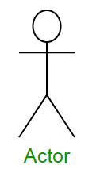
Sequence Diagram Notations
Actors :
An actor in a UML diagram represents a type of role where it interacts with the system and its objects.

Slide 89
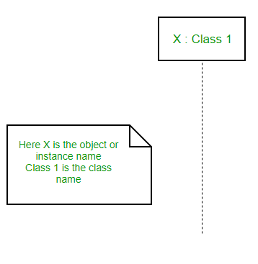
2.Lifelines :
A lifeline is a named element which depicts an individual participant in a sequence diagram. So basically each instance in a sequence diagram is represented by a lifeline.
Lifeline elements are located at the top in a sequence diagram.
lifeline follows the following format :
Instance Name : Class Name

Slide 90
3.Messages :
Communication between objects is depicted using messages. The messages appear in a sequential order on the lifeline.
We represent messages using arrows. Lifelines and messages form the core of a sequence diagram.

Slide 91
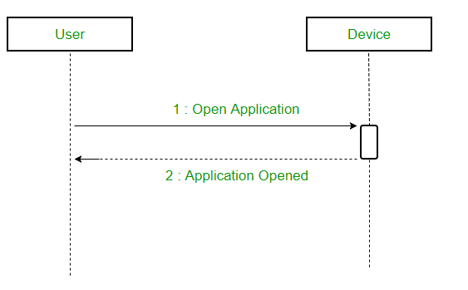
Synchronous messages
A synchronous message waits for a reply before the interaction can move forward.
The sender waits until the receiver has completed the processing of the message.
The caller continues only when it knows that the receiver has processed the previous message i.e. it receives a reply message.
A large number of calls in object oriented programming are synchronous. We use a solid arrow head to represent a synchronous message.

Slide 92
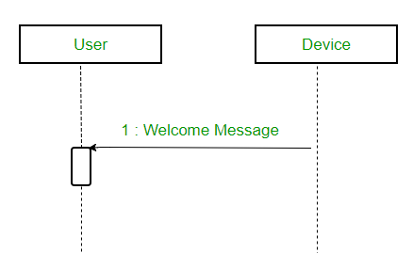
Asynchronous Messages
An asynchronous message does not wait for a reply from the receiver.
The interaction moves forward irrespective of the receiver processing the previous message or not.
We use a lined arrow head to represent an asynchronous message.

Slide 93
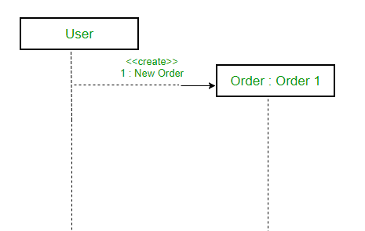
Create message
We use a Create message to instantiate a new object in the sequence diagram.
It is represented with a dotted arrow and create word labeled on it to specify that it is the create Message symbol. For example :
The creation of a new order on a e-commerce website would require a new object of Order class to be created.

Slide 94
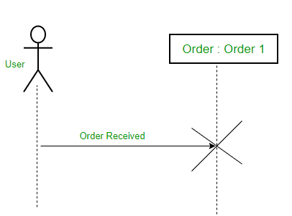
Delete Message
We use a Delete Message to delete an object.
It destroys the occurrence of the object in the system.
It is represented by an arrow terminating with a x. For example – In the scenario below when the order is received by the user, the object of order class can be destroyed

Slide 95
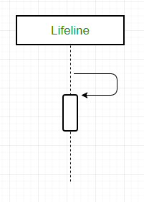
Self Message
A message an object sends to itself, usually shown as a U shaped arrow pointing back to itself.

Slide 96

Reply Message
Reply messages are used to show the message being sent from the receiver to the sender.
We represent a return/reply message using an open arrowhead with a dotted line.
The interaction moves forward only when a reply message is sent by the receiver.

Slide 97
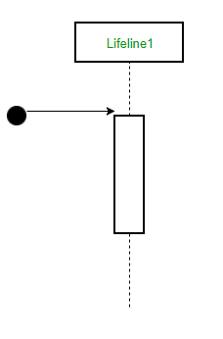
Found Message
A Found message is used to represent a scenario where an unknown source sends the message.
It is represented using an arrow directed towards a lifeline from an end point.

Slide 98
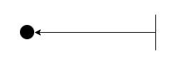
Lost Message
A Lost message is used to represent a scenario where the recipient is not known to the system.
It is represented using an arrow directed towards an end point from a lifeline.
For example:

Slide 99
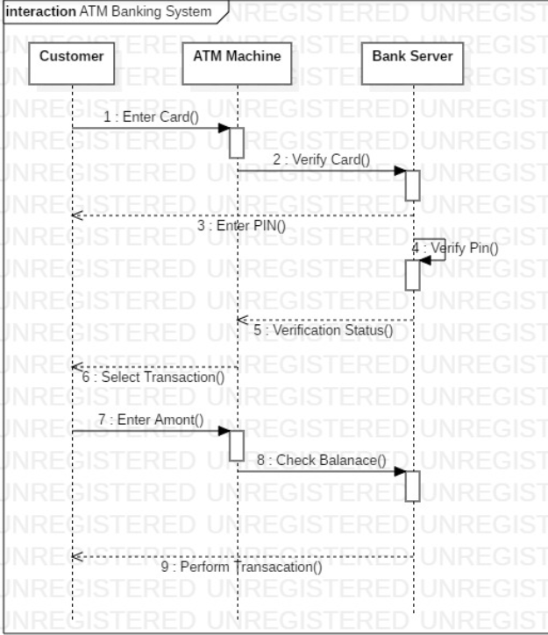
Example – Sequence Diagram

Slide 100
Questions
What does a message mean? a) It Passes all communications from one object to another and are represented by message arrows in sequence diagrams. b) The message goes from the sending object’s lifeline to the receiving object’s lifeline. c) It is a rectangle containing an identifier with a dashed line extending below the rectangle. d) List of all attributes.
What is a lifeline? a) It is a frame consisting of a rectangle with a pentagon in its upper left-hand corner b) It is a rectangle containing an identifier with a dashed line extending below the rectangle c) It is a name compartment; the interaction is represented inside the rectangle d) Emergency situation in real world approach.

